Slide 1
Lecture 19
Joinable and Detached Threads
National University of
Computer & Emerging Sciences

Slide 2
The Pthreads API
The subroutines which comprise the Pthreads API can be informally grouped into four major groups:
Thread management: Routines that work directly on threads - creating, detaching, joining, etc. They also include functions to set/query thread attributes (joinable, scheduling etc.)
Mutexes, Condition variables, Synchronization

Slide 3
Thread Creation
Initially, your main() program comprises a single, default thread. All other threads must be explicitly created by the programmer.
pthread_create creates a new thread and makes it executable. This routine can be called any number of times from anywhere within your code.

Slide 4
Thread Creation
pthread_create( pthread_t *threadid
,const pthread_attr_t *attr, void
*(*start_routine)(void *),void *arg);
threadid
  The routine returns the new thread ID via the threadid
  The caller can use this thread ID to perform various operations
  This ID should be checked to ensure that the thread was successfully created.
attr
  used to set thread attributes.
  NULL for the default values.
start_routine
  The C routine that the thread will execute once it is created.
arg
  Arguments are passed to start_routine via arg.
  Arguments must be passed by reference as pointers
  These pointers must be cast as pointers of type void.

Slide 5
#include <pthread.h>
#include <stdio.h>
#define NUM_THREADS 5
void * PrintHello(void *threadid)
{ printf("\n%d: Hello World!\n", threadid);
pthread_exit(NULL);
}
int main()
{
pthread_t threads[NUM_THREADS];
int rc, t;
for(t=0;t < NUM_THREADS;t++)
{
printf("Creating thread %d\n", t);
rc = pthread_create(&threads[t], NULL, PrintHello, (void *)&t);
if (rc)
{
printf("ERROR; return code from pthread_create() is %d\n", rc);
exit(-1);
}
}
pthread_exit(NULL); }

Slide 6
In main: creating thread 0
In main: creating thread 1
Hello World! It's me, thread #0!
In main: creating thread 2
Hello World! It's me, thread #1!
Hello World! It's me, thread #2!
In main: creating thread 3
In main: creating thread 4
Hello World! It's me, thread #3!
Hello World! It's me, thread #4!

Slide 7
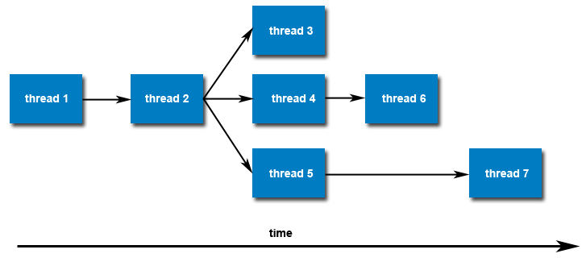
Thread Creation
Once created, threads are peers, and may create other threads. There is no implied hierarchy or dependency between threads.

Slide 8
Attribute Object
When an attribute object is not specified, it is NULL, and the default thread is created with the following attributes:
  It is non-detached
  It has a a default stack and stack size
  It inherits the parent's priority

Slide 9
Thread Suspension and Termination
Similar to UNIX processes, threads have the equivalent of the wait() and exit() system calls
pthread_join()
  Used to block threads
pthread_exit()
  Used to terminate threads
To instruct a thread to block and wait for a thread to complete, use the pthread_join() function.
This is also the mechanism used to get a return value from a thread
Any thread can call join on (and hence wait for) any other thread.

Slide 10
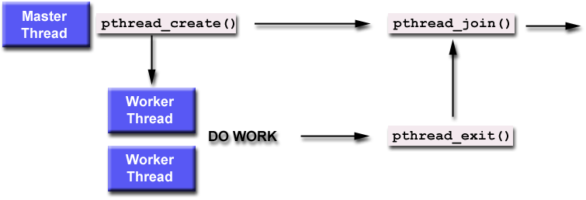
Thread Suspension and Termination

Slide 11
Joinable or Not?
When a thread is created, one of its attributes defines whether it is joinable or detached. Only threads that are created as joinable can be joined. If a thread is created as detached, it can never be joined.

Slide 12
Detached State
Each thread can be either joinable or detached.
Detached: on termination all thread resources are released by the OS.
A detached thread cannot be joined.
No way to get at the return value of the thread.

Slide 13
Joining thread
Joinable: on thread termination the thread ID and exit status are saved by the OS.
Joining a thread means waiting for a thread
pthread_join(threadid, status)
  "Joining" is one way to accomplish synchronization between threads.
  subroutine blocks the calling thread until the specified threadid thread terminates.
    The programmer is able to obtain the target thread's termination return status (if specified) in the status parameter.
It is impossible to join a detached thread

Slide 14
Joining thread
Multiple threads cannot wait for the same thread to terminate.
If they try to, one thread returns successfully
The others fail with an error of ESRCH
After pthread_join() returns, any stack storage associated with the thread can be reclaimed by the application.
Threads which have exited but have not been joined are equivalent to zombie processes.
Their resources cannot be fully recovered.

Slide 15
To explicitly create a thread as joinable or detached, the attr argument in the pthread_create() routine is used. The typical 4 step process is:
Declare a pthread attribute variable of the pthread_attr_t data type
Initialize the attribute variable with pthread_attr_init()
Set the attribute detached status with pthread_attr_setdetachstate()
When done, free library resources used by the attribute with pthread_attr_destroy()

Slide 16
#include <pthread.h>
#include <stdio.h>
#include <stdlib.h>
#include <math.h>
#define NUM_THREADS 4
void *BusyWork(void *t)
{
int i;
long tid;
double result=0.0;
tid = (long)t;
printf("Thread %ld starting...\n",tid);
for (i=0; i<1000000; i++)
{
result = result + sin(i) * tan(i);
}
printf("Thread %ld done. Result = %e\n",tid, result);
pthread_exit((void*) t);
}

Slide 17
int main (int argc, char *argv[])
{
pthread_t thread[NUM_THREADS];
pthread_attr_t attr;
int rc;
long t;
void *status;
/* Initialize and set thread detached attribute */
pthread_attr_init(&attr);
pthread_attr_setdetachstate(&attr, PTHREAD_CREATE_JOINABLE);
for(t=0; t<NUM_THREADS; t++) {
printf("Main: creating thread %ld\n", t);
rc = pthread_create(&thread[t], &attr, BusyWork, (void *)t);
if (rc) {
printf("ERROR; return code from pthread_create()
is %d\n", rc);
exit(-1);
}
}

Slide 18
/* Free attribute and wait for the other threads */
pthread_attr_destroy(&attr);
for(t=0; t<NUM_THREADS; t++) {
rc = pthread_join(thread[t], &status);
if (rc) {
printf("ERROR; return code from pthread_join()
is %d\n", rc);
exit(-1);
}
printf("Main: completed join with thread %ld having a status
of %ld\n",t,(long)status);
}
printf("Main: program completed. Exiting.\n");
pthread_exit(NULL);
}

Slide 19
Main: creating thread 0
Main: creating thread 1
Thread 0 starting...
Main: creating thread 2
Thread 1 starting...
Main: creating thread 3
Thread 2 starting...
Thread 3 starting...
Thread 1 done. Result = -3.153838e+06
Thread 0 done. Result = -3.153838e+06
Main: completed join with thread 0 having a status of 0
Main: completed join with thread 1 having a status of 1
Thread 3 done. Result = -3.153838e+06
Thread 2 done. Result = -3.153838e+06
Main: completed join with thread 2 having a status of 2
Main: completed join with thread 3 having a status of 3
Main: program completed. Exiting.

Slide 20
pthread_detach()
By default threads are created joinable.
Instead of waiting for a child, a parent thread can specify that
  it does not require a return value
  or any explicit synchronization with that thread.
To do this, the parent thread uses the pthread_detach() function.
After this call, there is no thread waiting for the child – it executes independently until termination.
To avoid memory leaks a thread should
  either be joined
  Or detached by a call to pthread_detach()
int pthread_detach(pthread_t tid);
  Returns 0 on OK, nonzero on error
Threads can detach themselves by calling pthread_detach with an argument of pthread_self

Slide 21
#include<stdio.h>
#include<pthread.h>
void run() {
pthread_exit(0);
}
int main () {
pthread_t thread;
int rc;
long count = 0;
while(1) {
if(rc = pthread_create(&thread, 0, run, 0) ) {
printf("ERROR, rc is %d, so far %ld threads created\n", rc, count);
perror("Fail:");
return -1;
}
count++;
}
return 0;
}
Notes:
[root@server ~]# ./thread
ERROR, rc is 12, so far 304 threads created
Fail:: Cannot allocate memory

